Slide 1
Unit-II Visualizing Distributions

Slide 2
Bar plots
A bar chart or bar graph is a chart or graph that presents categorical data with rectangular bars with heights or lengths proportional to the values that they represent.
Quantitative visualization for tabular data.
X-Y correlation (function) need not be there.
It shows data that falls into discrete categories.
Characters are allowed at x-axis

Slide 3
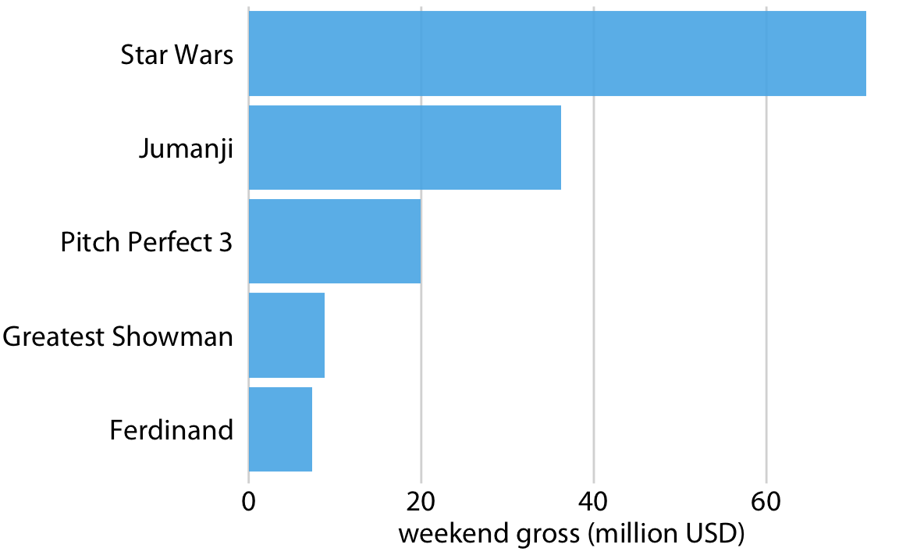
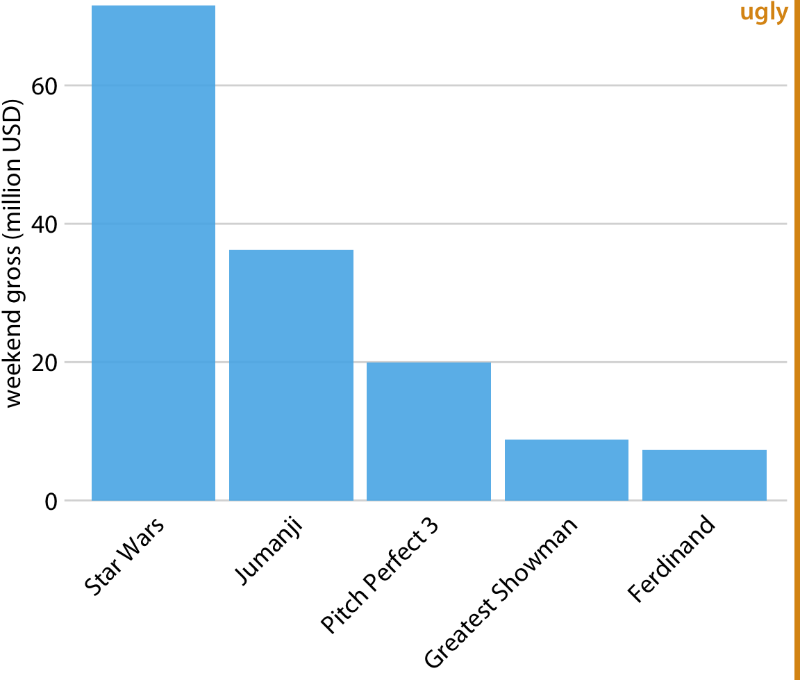
Bar plots

Slide 4
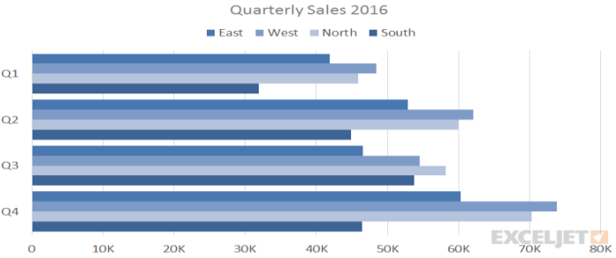
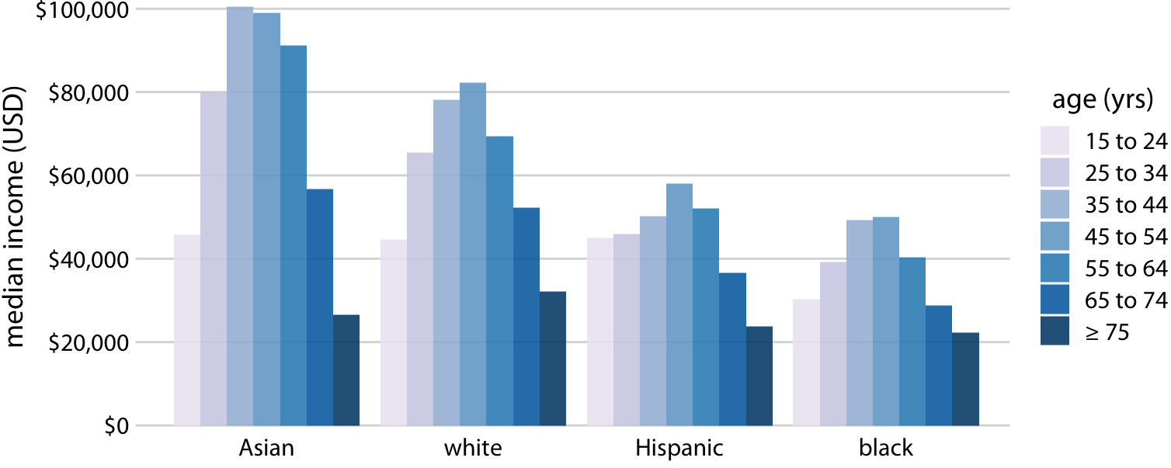
Grouped Bar Chart
A grouped bar chart is a type of bar graph that is used to represent and compare different categories of two or more groups.
Width of each column is fixed but height is proportional to the quantity they want to show.

Slide 5
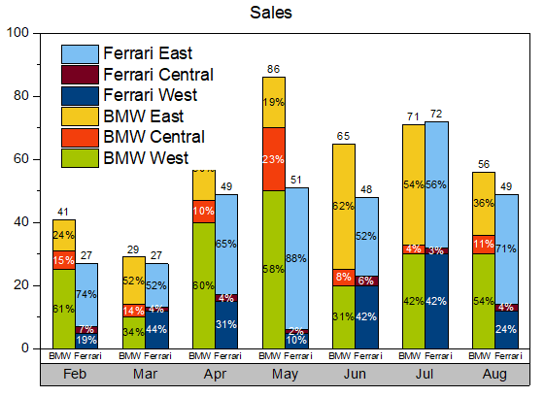
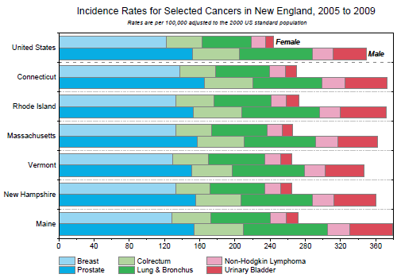
Stacked bar graph

